Slide 1


Wine Quality & Datasets

Slide 2

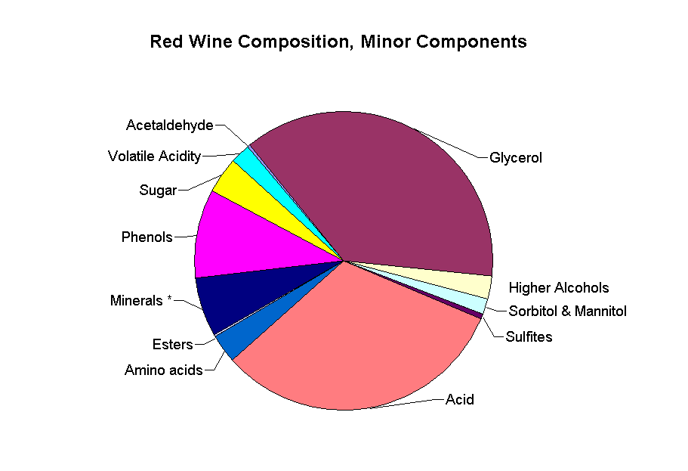
Introduction
Industry participants now use product quality certifications to market their goods. This is a time-consuming process that also costs a lot of money because it needs to be evaluated by human experts. Additionally, the cost of red wine is determined by tasters' opinions, which can vary greatly and are based on an abstract concept of wine appreciation. Physicochemical tests, which are laboratory-based and take into account elements like acidity, pH level, sugar, and other chemical qualities, are an additional crucial component in the certification of red wine and the evaluation of its quality.

Slide 3
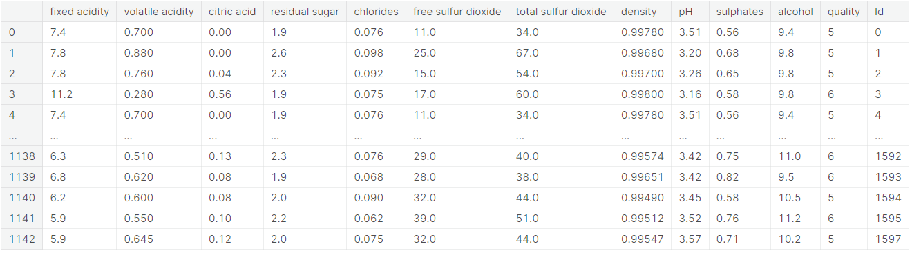
Exploring the Data

Slide 4
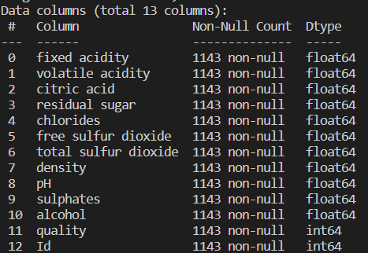
Datasets
 | B2B | Supply chain | ROI | E-commerce
Q1 | 4.5 | 2.3 | 1.7 | 5.0
Q2 | 3.2 | 5.1 |  | 3.0
Q3 | 2.1 | 1.7 | 2.5 | 2.8
Q4 | 4.5 | 2.2 | 1.7 | 70

Slide 5
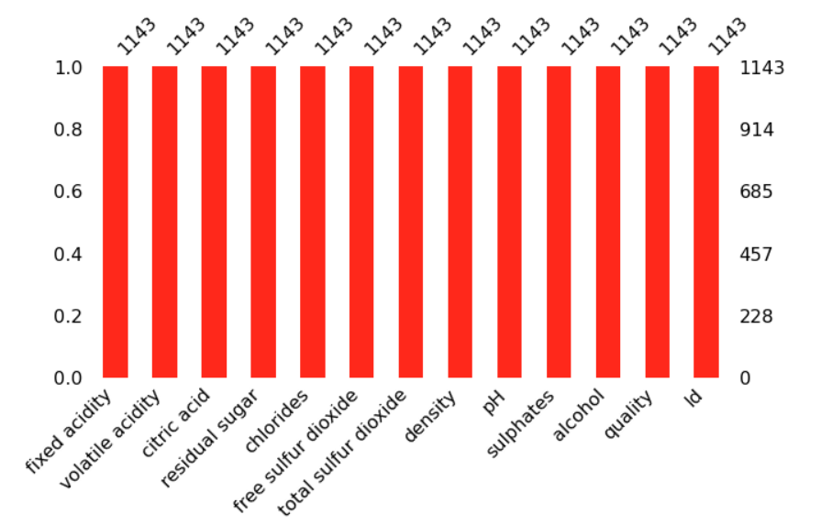
Components of The Data

Slide 6
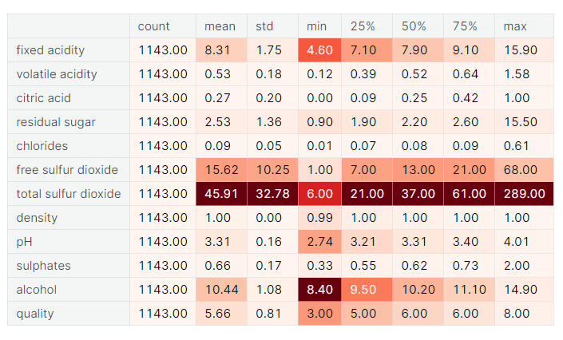
Exploring the variable

Slide 7
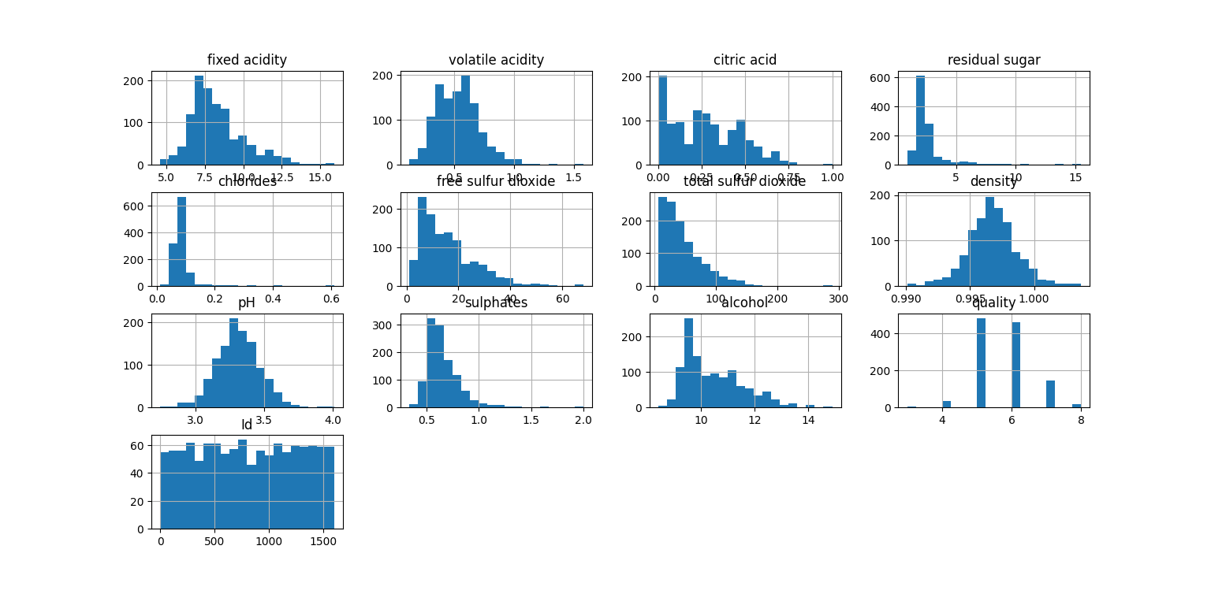
Results from the Datasets
“
”

Slide 8
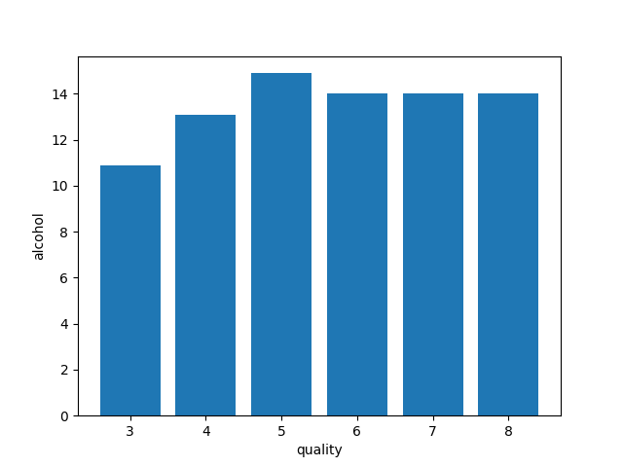
Alcohol Vs Quality

Slide 9
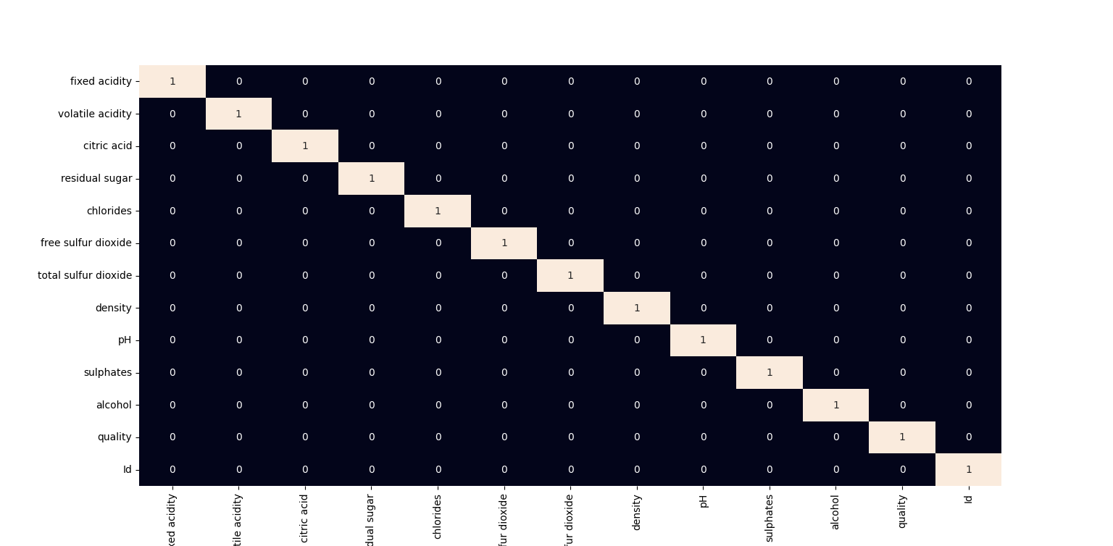

Slide 10
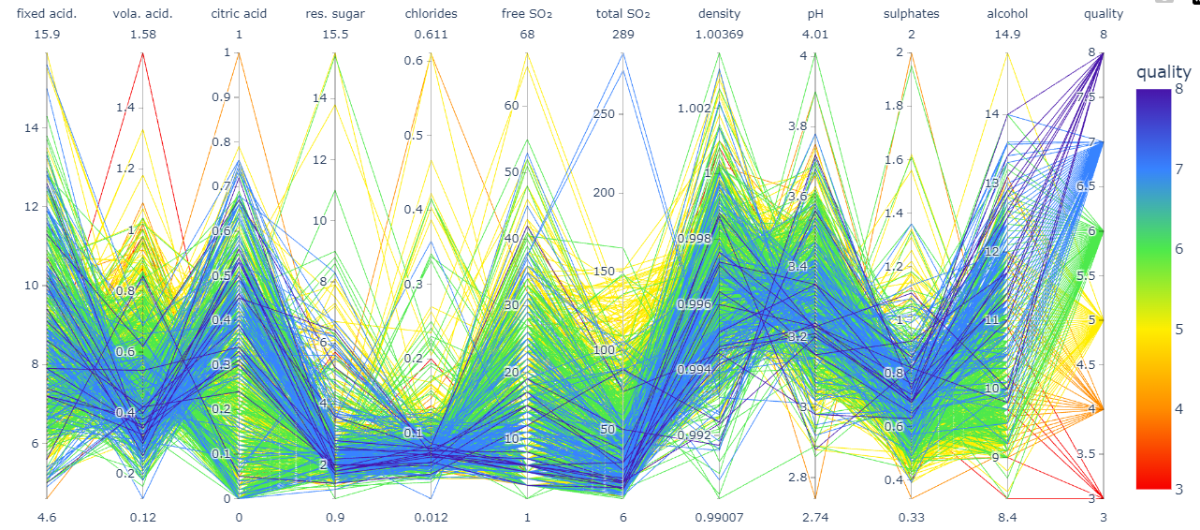
Visualising the given Ingredients Data Ratios

Slide 11
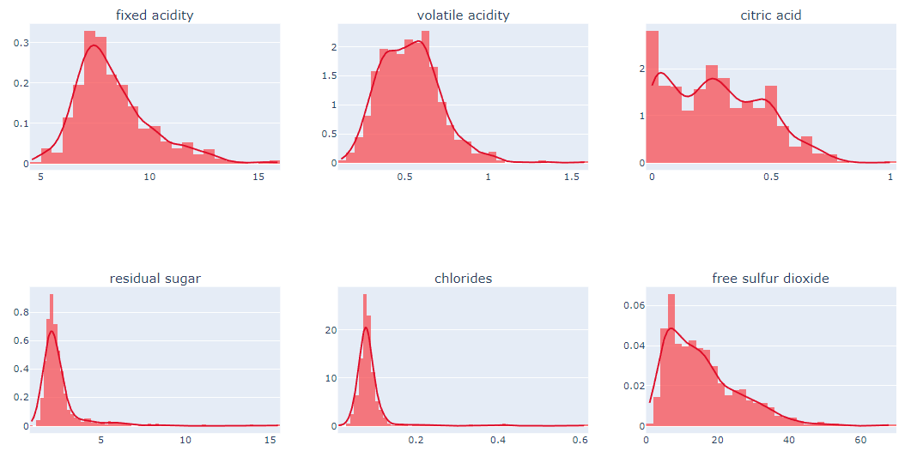
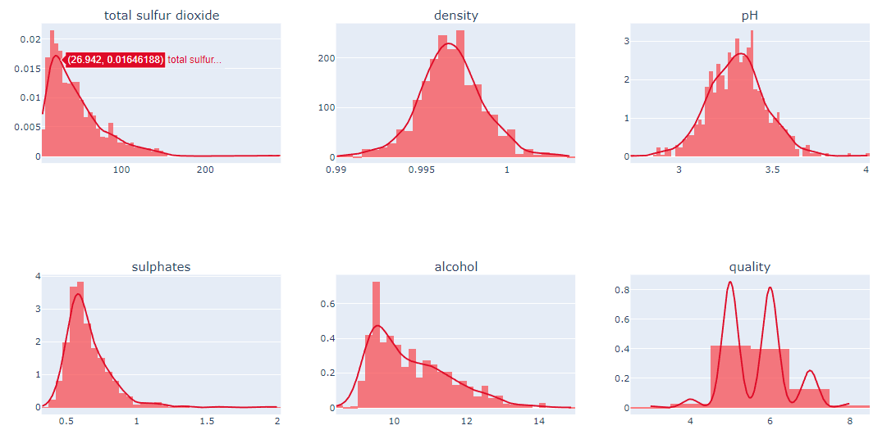
Histogram

Slide 12
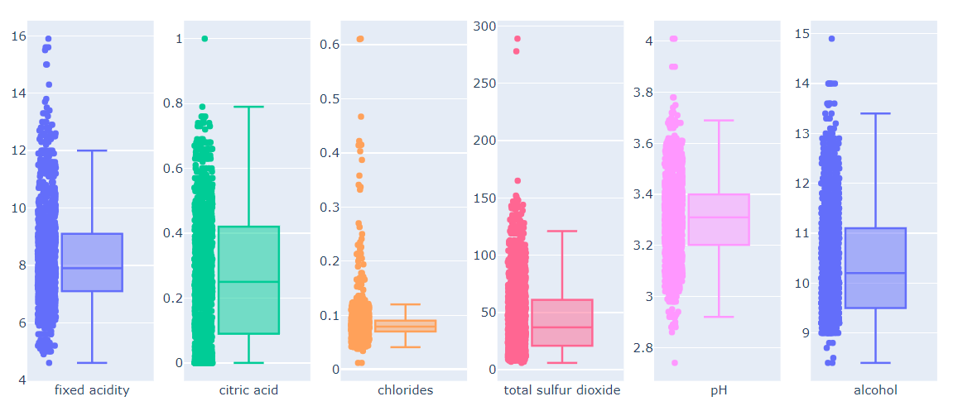
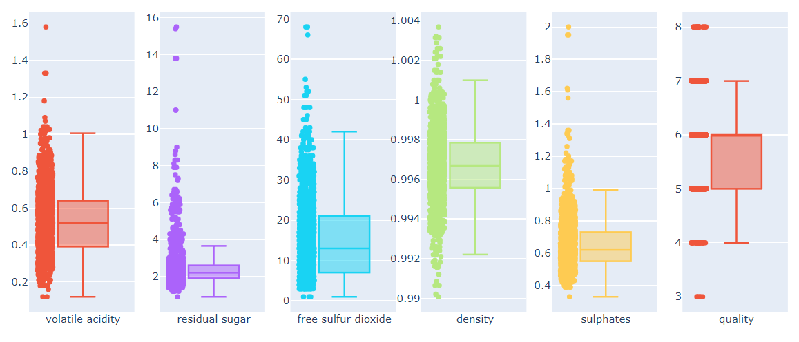
Boxplot

Slide 13
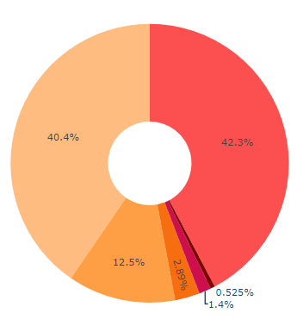
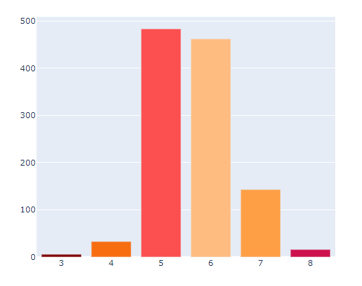
Distribution of the Target Variable

Slide 14
PREDICTION ACCURACY
87.056 %

Slide 15
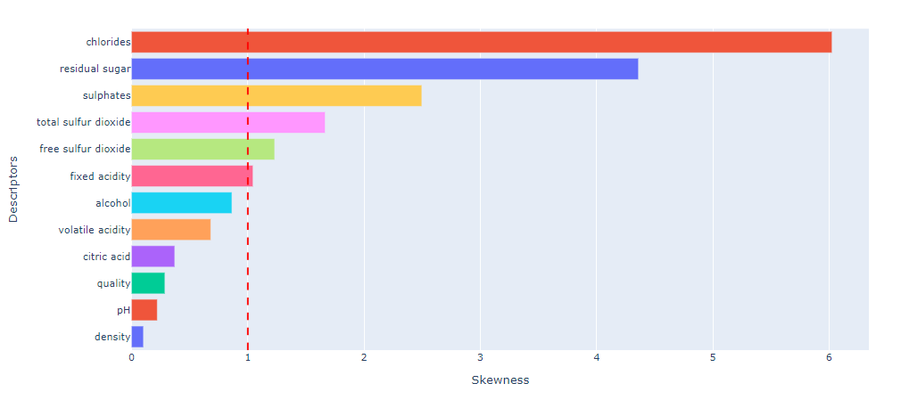
Skewness
Plot to show the skewness in data. If the skewness is high it means that the data is not normally distrbuted.

Slide 16

Summary
At last we got the brief description and explanation of the Ingredients of Wines with it’s chemical composition and it’s nature , pH and etc. We required the different knowledge about it and data for representation.

